Slide 1
Hadoop Yarn Introduction
Hadoop Distributed File System (HDFS)
http://hadoop.apache.org/docs/stable/index.html

Slide 2
Hadoop Main Job
Hadoop Distributed File System (HDFS)
Yarn
Resource scheduler
Map-Reduce Job
Substitute this feature with Spark

Slide 3
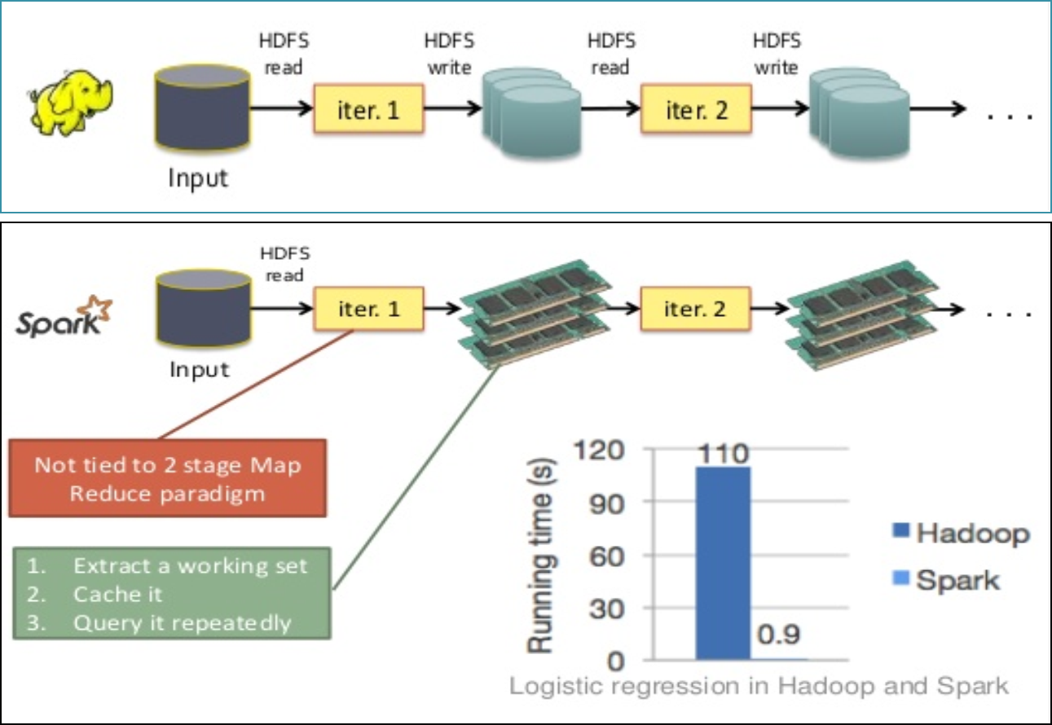
File-Based vs Memory-Based MR

Slide 4
Agenda
HDFS
YARN

Slide 5

Hadoop HDFS Architecture
Single Point of Failure
Master
Slave
Slave

Slide 6
Hadoop HDFS Architecture
Namenode
the center of an HDFS file system. It keeps the directory tree of all files in the file system, and tracks where across the cluster the file data is kept.
Datanode
stores data. A functional filesystem has more than one DataNode, with data replicated across them.
Notes:
The NameNode stores modifications to the file system as a log appended to a native file system file, edits. When a NameNode starts up, it reads HDFS state from an image file, fsimage, and then applies edits from the edits log file. It then writes new HDFS state to the fsimage and starts normal operation with an empty edits file. Since NameNode merges fsimage and edits files only during start up, the edits log file could get very large over time on a busy cluster. Another side effect of a larger edits file is that next restart of NameNode takes longer.

Slide 7
Hadoop HDFS Architecture
Replication
Backup file for failure over, default 3
Block
HDFS the min storage unit
Rack
Cluster divided from different domain, for replication use

Slide 8
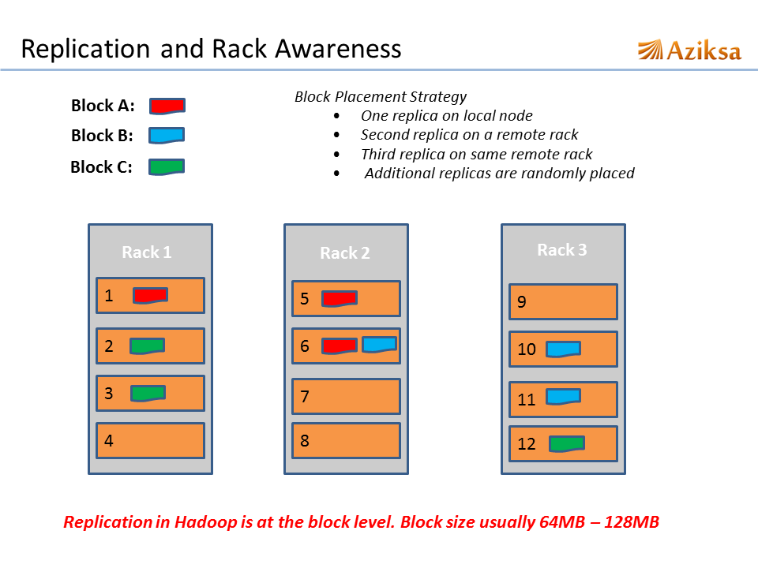
IP: 10.115.1.X
IP: 10.115.2.X
IP: 10.115.3.X

Slide 9
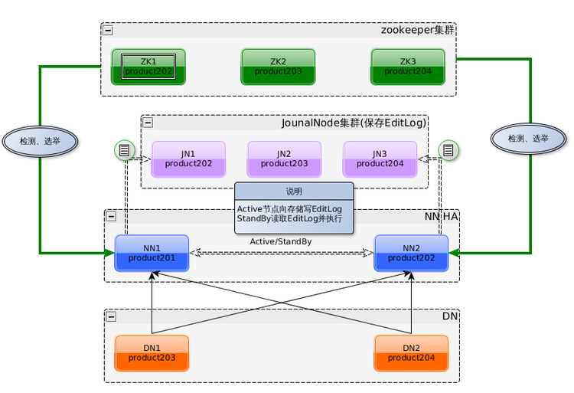
Hadoop Namenode HA
Solve namenode SPF
Notes:
http://mmicky.blog.163.com/blog/static/150290154201401812127758/;

Slide 10
Agenda
HDFS
YARN

Slide 11
Hadoop Yarn

Slide 12
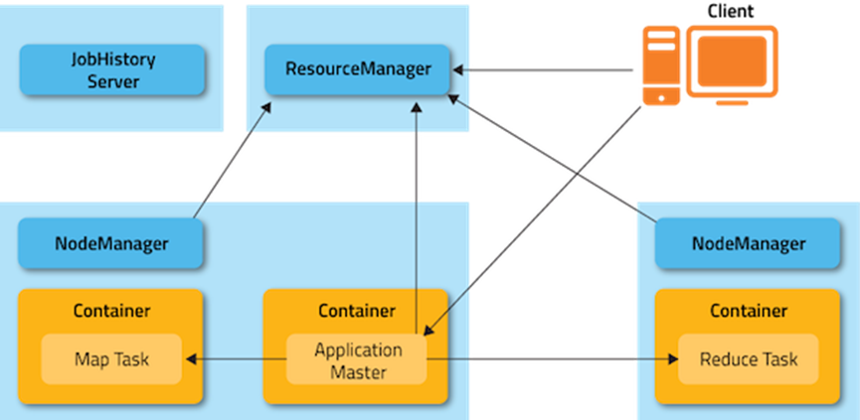
Yarn
SOPF
RM
(1)
(5)
(5)
(2)
(4)
(3)
(6)
(6)
AM

Slide 13
Yarn
(1) Client Send a Map-Reduce Job to RM
(2) RM send a request to scheduler to create AM container and launch AM, AM register to RM
(3) Client get AM Info from RM, and talks to AM
(4) AM calculate Job map reduce task resource, and talk to RM to request task resources. RM dispatch task resource container

Slide 14
Yarn
(5) NM launch container, monitor task resources and heartbeat its status to RM, (6) AM monitor task complete status, and get job result

Slide 15
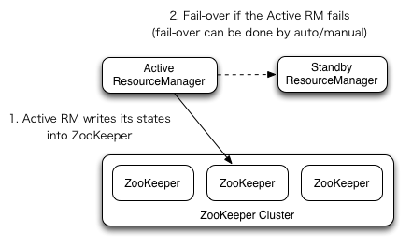
ResourceManager HA

Slide 16
Hadoop Command
http://hadoop.apache.org/docs/current/hadoop-project-dist/hadoop-common/CommandsManual.html
http://hadoop.apache.org/docs/r2.3.0/hadoop-project-dist/hadoop-common/FileSystemShell.html
http://debugo.com/hdfs-fscmd/

Slide 17
Hadoop Quota
File Count Quota
File Size Quota
hadoop fs -count -q
http://hadoop.apache.org/docs/current/hadoop-project-dist/hadoop-hdfs/HdfsQuotaAdminGuide.html

Slide 18
Hadoop Backup
Snapshot
http://hadoop.apache.org/docs/r2.3.0/hadoop-project-dist/hadoop-hdfs/HdfsSnapshots.html
Distcp
http://hadoop.apache.org/docs/r1.2.1/distcp.html

Slide 19
Hadoop Demo
Console CLI
Java write file
Port 8088 for YARN
Port 50070 for HDFS

Slide 20
Thanks for your attention

